Slide 1

Black Friday Sales Prediction Using Machine Learning
Team Members:
Akhil Devaki – 700741677
SaiKrishna Peruka – 700740918
Srujana Reddy Makutam – 700740914
Tejaswini Sankoju - 700726283

Slide 2
Roles and responsibilities:
Team Member 1 worked on the coding for the XGBoost Model and Random Forest algorithm.
Team member 2 worked on the documentation for the project.
Team Member 3 worked on the features derivation for the project to move forward.
Team member 4 worked on the reference papers and helped in choosing the models based on existing models.

Slide 3
Motivation:
Use of device gaining knowledge of throughout industries together with finance, sales, and advertising .
Foresee how moves will affect the evolution for any company.
Understanding the acquisition styles of the clients’ shops supplying progressed carrier quality.
Growing the sales.

Slide 4

Objectives:
Predicting purchase:
Developing a machine learning algorithm to show how much a customer can spend.
Pattern recognition:
Understanding the factors from data which influence spending.
Quantitative impact of revealed factors.

Slide 5

Related work:
Many applications available to predict sales in e commerce like time series prediction etc.
Overrun by crowd, deeply discount on products.
First work used linear regression model to predict.
Finally, purchasing patterns, as well as future consumer intentions, are presented.

Slide 6

Problem Statement:
Understanding the customer purchase activity especially purchase amount based on various products and different categories.
Shared the purchase summary of many customers on selected products which are of high volume.

Slide 7

Proposed Solution:
Random Forest
Further the regression but also classification objectives are sometimes accomplished
Without always relying on just one DT, the random forest philosophy uses several DT.
XGBoost
Range of regularizations that lessen overfitting and enhance overall efficiency.
utilizing suitable normalization methods and improving particular loss functions.

Slide 8
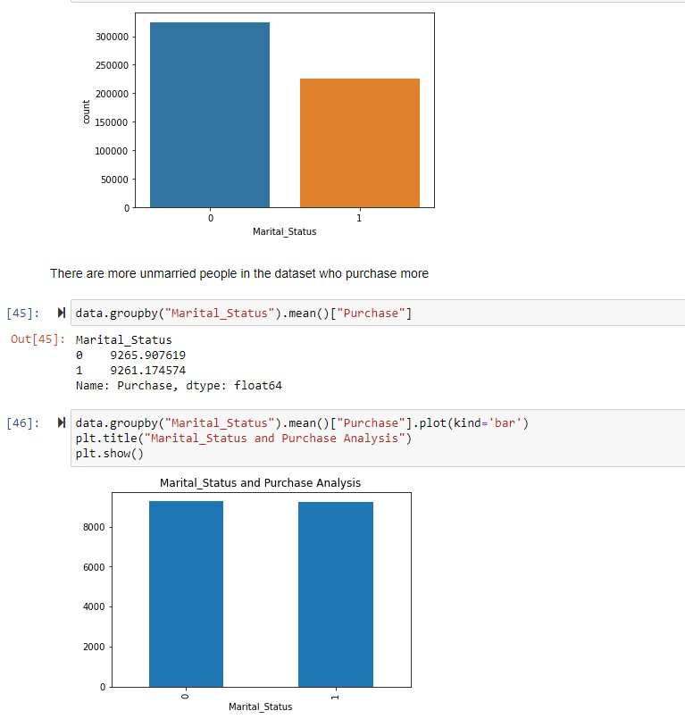
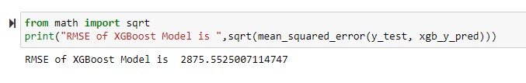
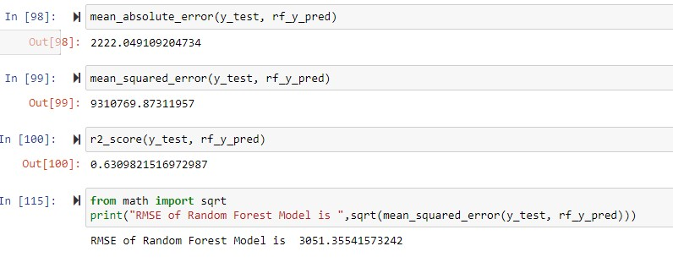
Results\Simulations:

Slide 9
References:
C. M. Wu, P. Patil and S. Gunaseelan, "Comparison of Different Machine Learning Algorithms for Multiple Regression on Black Friday Sales Data," 2018 IEEE 9th International Conference on Software Engineering and Service Science (ICSESS), 2018, pp. 16-20, doi: 10.1109/ICSESS.2018.8663760.
Odegua, Rising. (2020). Applied Machine Learning for Supermarket Sales Prediction.
Purvika Bajaj1, Renesa Ray2, Shivani Shedge3, Shravani Vidhate4, Prof. Dr. Nikhilkumar Shardoor5,”SALES PREDICTION USING MACHINE LEARNING ALGORITHMS'',International Research Journal of Engineering and Technology (IRJET) ,Vol 7 Issue 6,2020,eISSN: 2395-0056 p-ISSN: 2395-0072.
Ramasubbareddy S., Srinivas T.A.S., Govinda K., Swetha E. (2021) Sales Analysis on Back Friday Using Machine Learning Techniques. In: Satapathy S., Bhateja V., Janakiramaiah B., Chen YW. (eds) Intelligent System Design. Advances in Intelligent Systems and Computing, vol 1171. Springer, Singapore.
Potturi, Keerthan, "Black Friday A study of consumer behavior and sales predictions" (2021). Creative Components.

Slide 10


